Slide 1
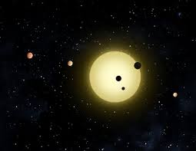

Exoplanets
Exploratory Data Analysis (eda)
By Mario Aldana

Slide 2
Question
Are the ellipses perimeters influenced by the exoplanet detection methods?

Slide 3
Dataset
This project is to analyze Exoplanets from exoplanet.eu database.
The database has 129 columns or variables. This is a database that constantly is being updated with new observations.

Slide 4
Variables (I)
1. mass: planetary mass.
2. period: orbital period around the star.
3. detection type: method used to discover the exoplanet
4. semi major axis: the semi-major axis is half of the longest diameter of an ellipse.

Slide 5
Variables (II)
5. semi minor axis: [derived variable] minor semi-axis is a line segment that is at right angles with the semi-major axis and has one end at the center.
6. eccentricity: the eccentricity is a measure of how much an ellipse is squashed. This is the shape of the ellipse.
7. star distance: distance to a host star.
8. ellipse: [derived variable] total ellipse perimeter.

Slide 6
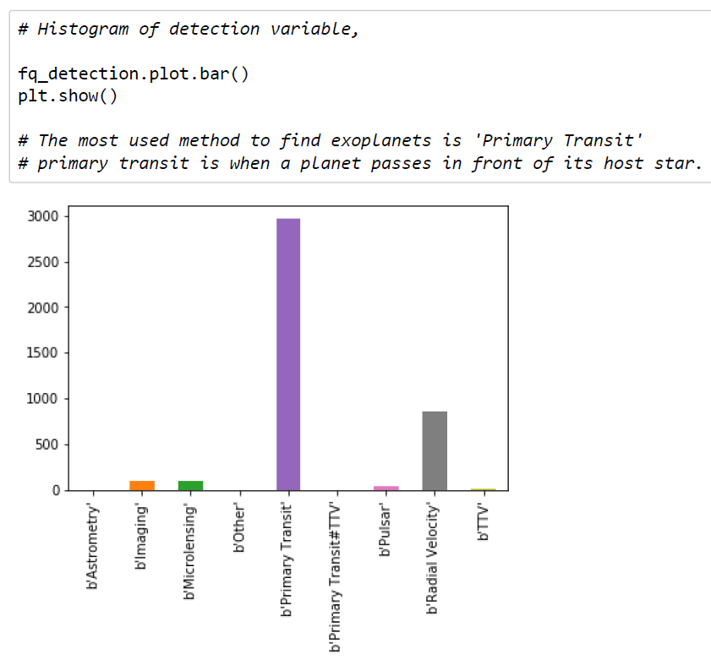
Most used method to find exoplanets

Slide 7
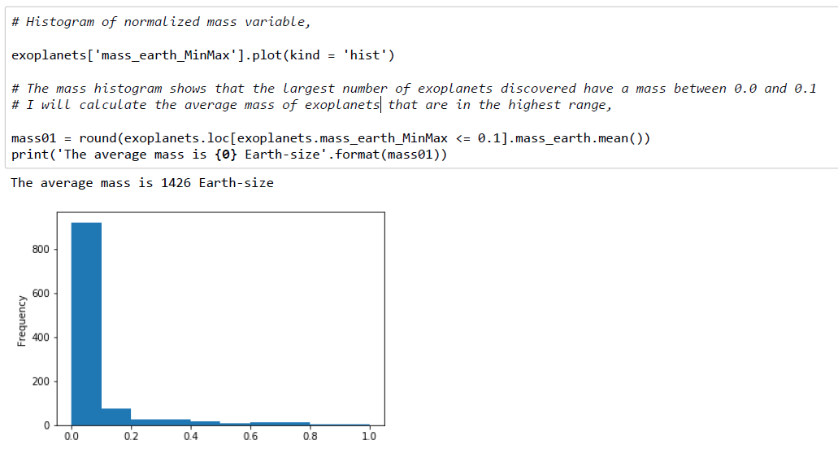
the average mass of exoplanets

Slide 8
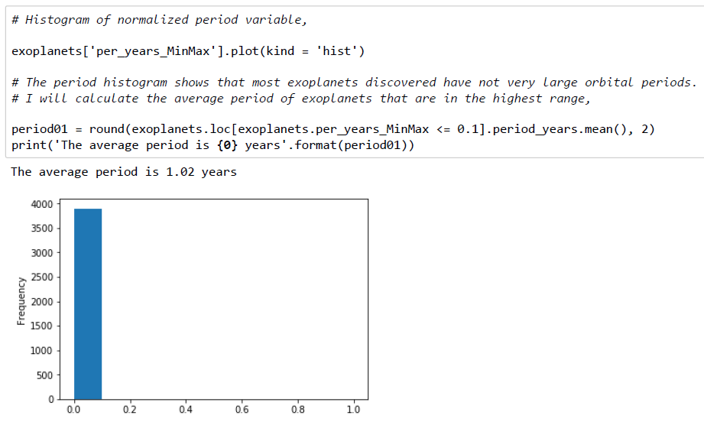
the average period of exoplanets

Slide 9
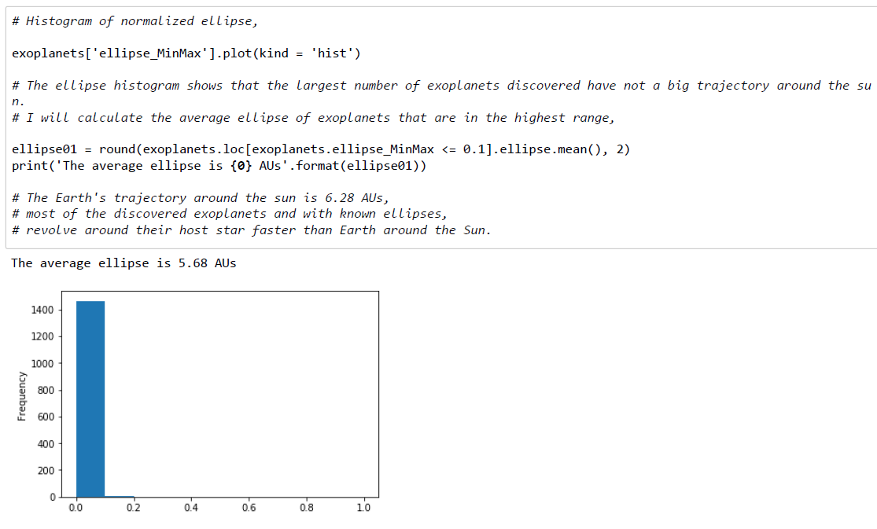
the average ellipse of exoplanets

Slide 10
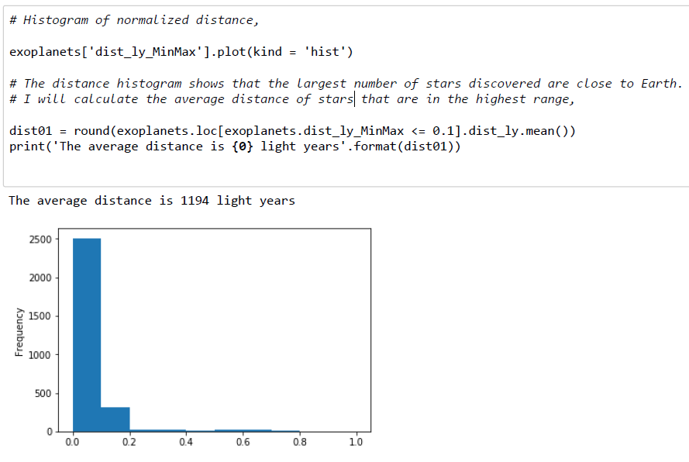
the average distance of stars

Slide 11
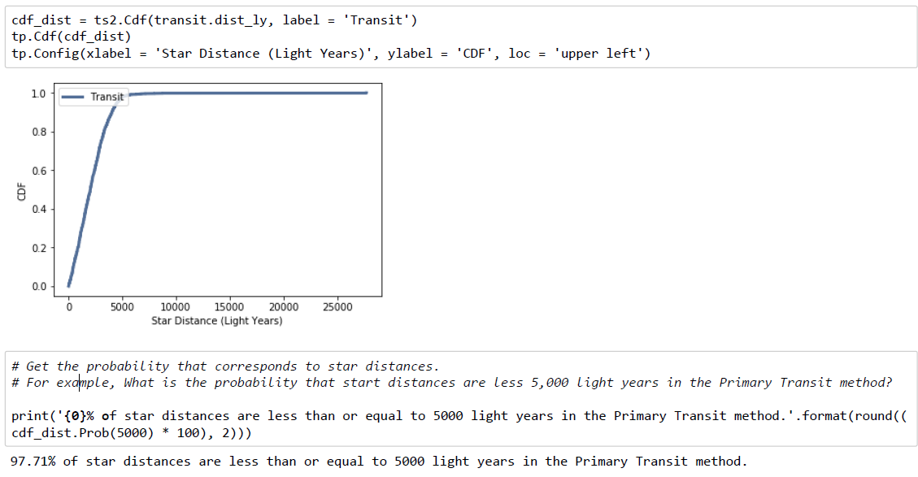
What is the probability that start distances are less 5,000 light years in the Primary Transit method?

Slide 12
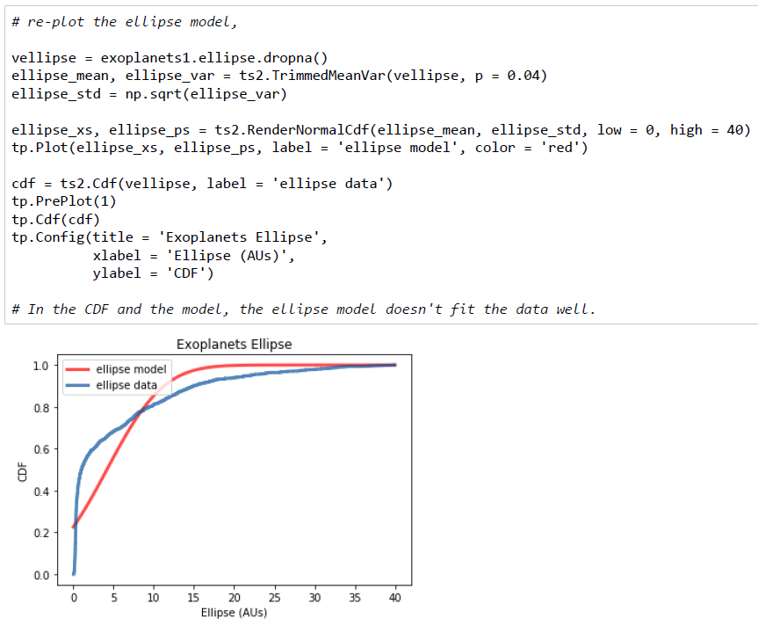
ellipse Variable model - CDF

Slide 13
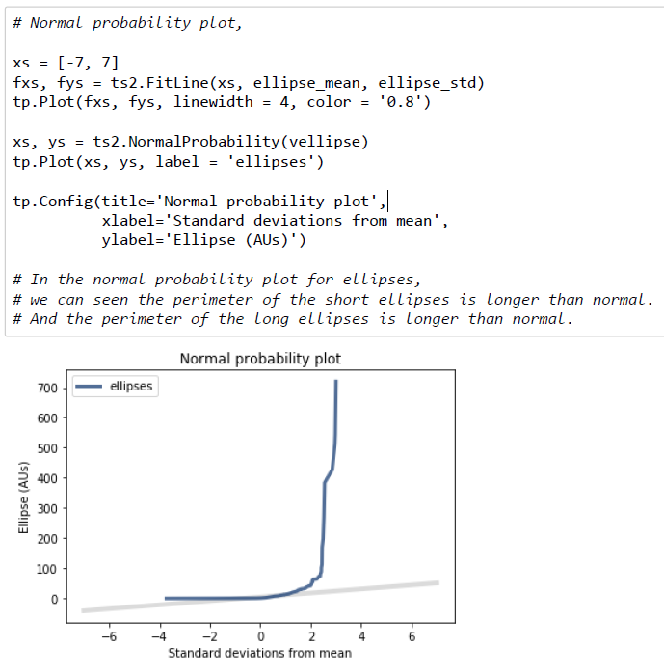
Normal probability

Slide 14
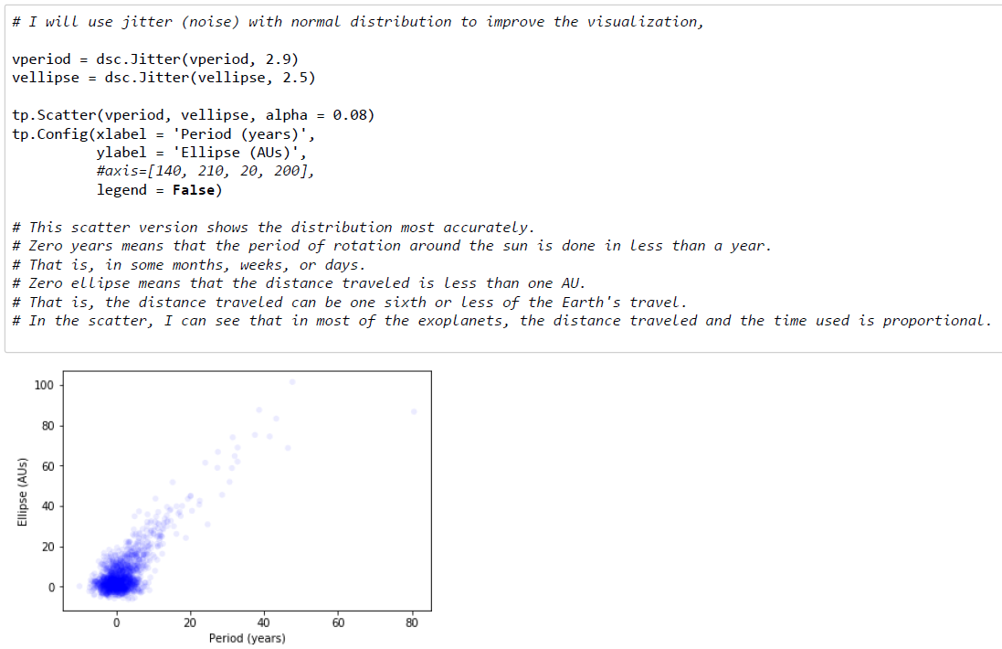
Correlation and Causation Analysis

Slide 15
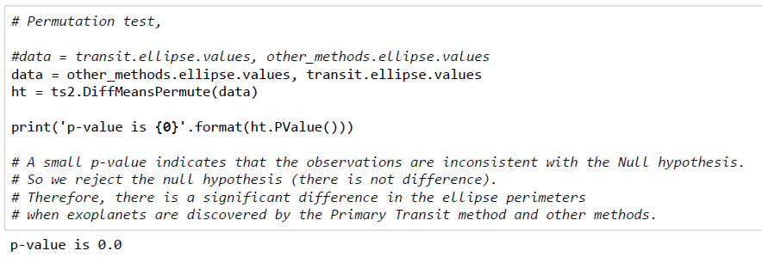
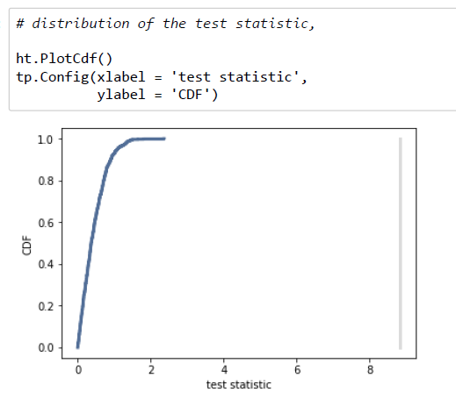
Conduct a test on my hypothesis

Slide 16
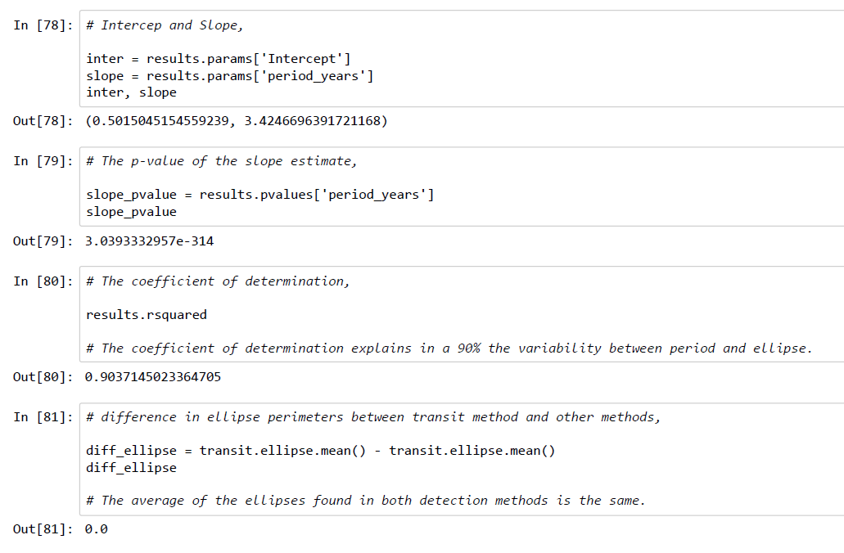
Regression Analysis (I)

Slide 17
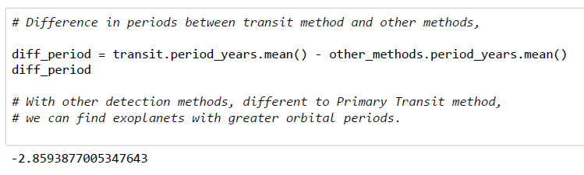
Regression Analysis (II)

Slide 18
link to my repository
https://github.com/moaldana/exoplanets

